Slide 1
MOBILE PRICE RANGE PREDICTION

Slide 2


PROJECT NAME :- MOBILE PRICE RANGE PREDICTION.
NAME:- KAPIL VIJAY GHAG.
IT VEDANT THANE.
DESCRIPTION:-
Title: Mobile Price Prediction with ML
Description: Utilizing machine learning, this project aims to predict the price range of mobile devices based on their specifications. Through data preprocessing, feature selection, model training, and evaluation, the project will develop a reliable tool for consumers and manufacturers in the smartphone market.

Slide 3
MOTIVATION:
1. Empower Consumers: Assist consumers in making informed purchasing decisions by providing accurate price estimates based on device specifications.
2. Market Insights: Enable manufacturers and retailers to understand price trends and consumer preferences for competitive pricing strategies.
3. Enhanced User Experience: Simplify the process of comparing and selecting smartphones, improving user satisfaction.
4. Business Efficiency: Automate pricing decisions to optimize inventory management and resource allocation, enhancing profitability.
5. Research and Innovation: Contribute to the advancement of machine learning techniques and algorithms through exploring complex relationships in mobile pricing data.

Slide 4
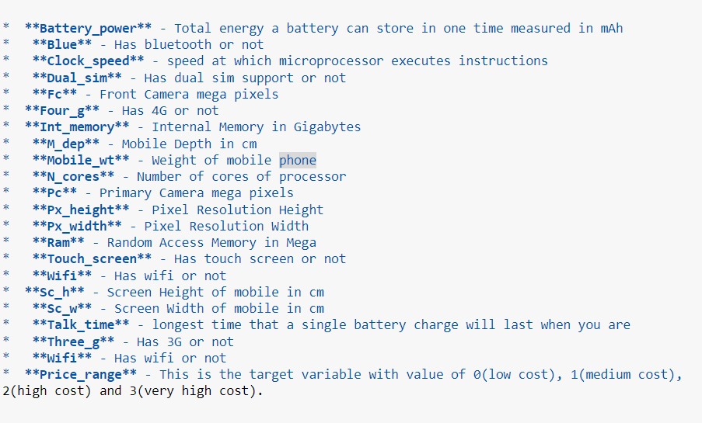
FEATURES DESCRIPTION:

Slide 5
STEP 0:- LOAD LIBRARIES AND DATASET:
Import numpy as np
Import pandas as pd
Import matplotlib.pyplot as plt
Import seaborn as sns
From sklearn.ensemble import Randomforestclassifer
From sklearn.neighbors import KNeighborsClassifier
From sklearn.tree import DecisiontreeClassifier
From sklearn.pipeline import make_pipeline
From sklearn.preporcesing import StandardScaler
From sklearn.ensemble import StackingClassifier
From sklearn.imput import Simletmputer
From sklearn.model_selection import cross_val_score
From sklearn.model_selection import RepeatedStratifiedKflod
From sklearn.model_selection import GridsearchCV
Importwarnings.filterwarning(“ignore”)

Slide 6
STEP 1:- IMPORTING DATASET:
# Loading the dataset
df = pd.read_csv(r"C:\Users\visha\Downloads\data_mobile_price_range.csv")
#Return the first 5 rows of the DataFrame
df

Slide 7
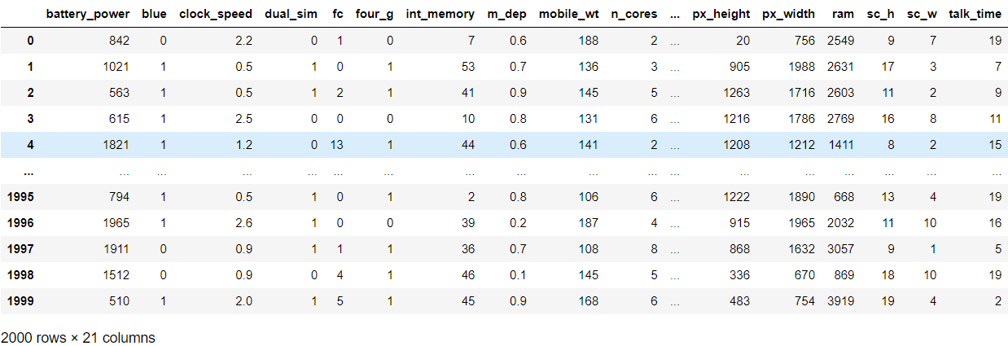
LOADING THE DATASET

Slide 8
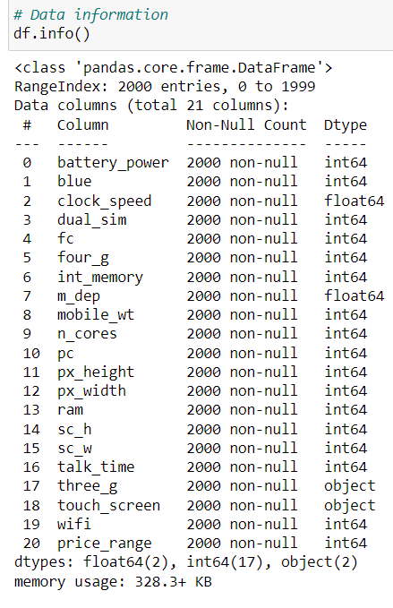
STEP 2:- EXPLORATORY DATA ANALYSIS:

Slide 9
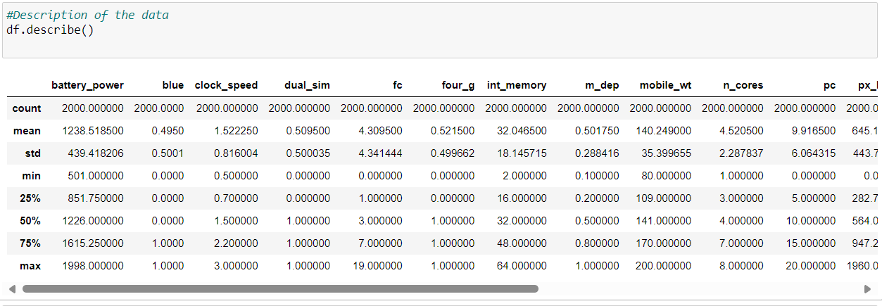

Slide 10
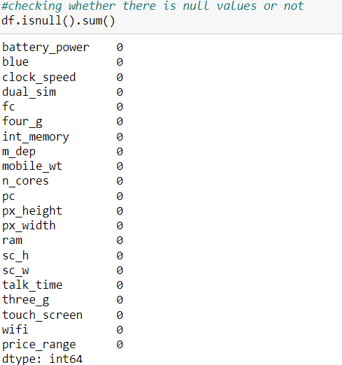
#CHECKING WHETHER THERE IS NULL VALUES OR NOT.

Slide 11
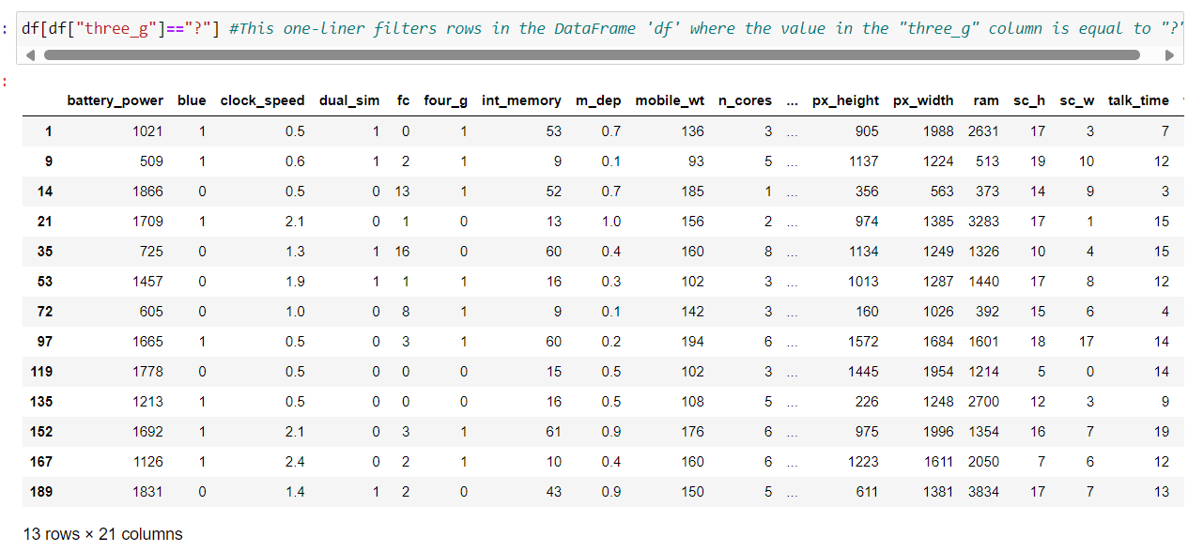
#This one-liner filters rows in the DataFrame 'df' where the value in the "three_g" column is equal to "?".

Slide 12
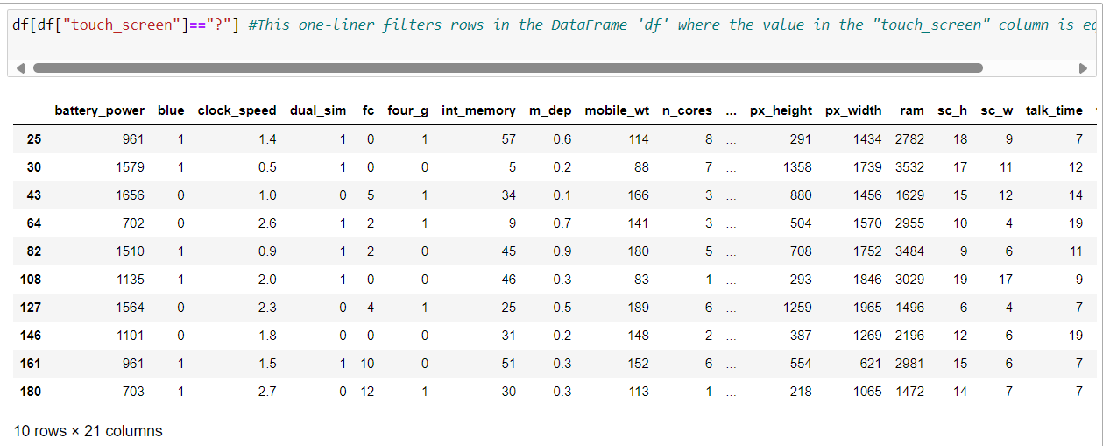
This one-liner filters rows in the DataFrame 'df' where the value in the "touch_screen" column is equal to "?".

Slide 13
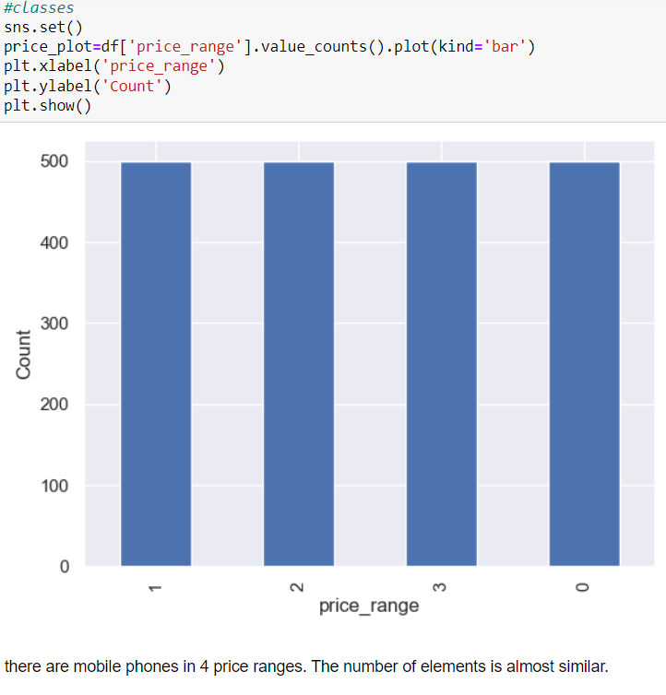
VISUALIZATION:

Slide 14
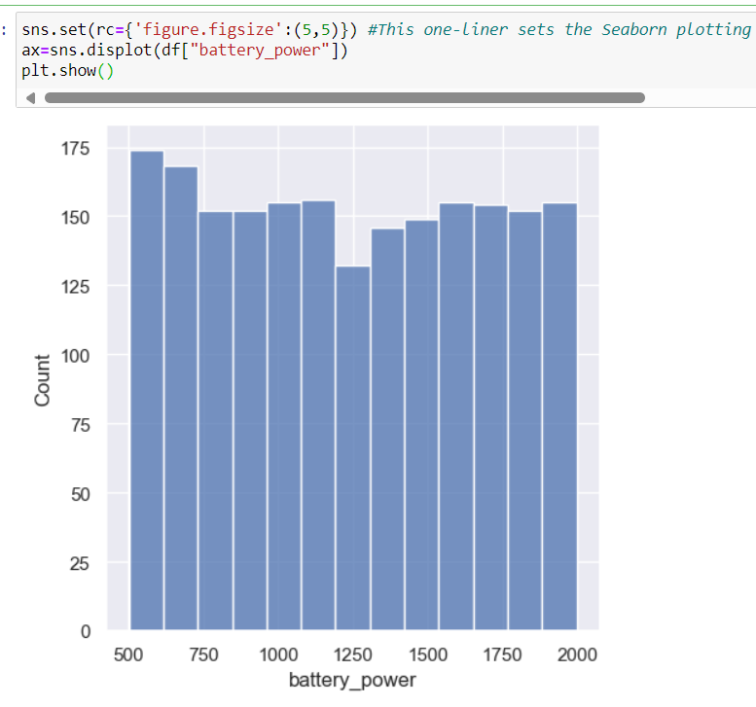
#This one-liner sets the Seaborn plotting style with a specific figure size, creates a distribution plot (histogram) for the 'battery_power' column in the DataFrame 'df', and displays the plot using Matplotlib.

Slide 15
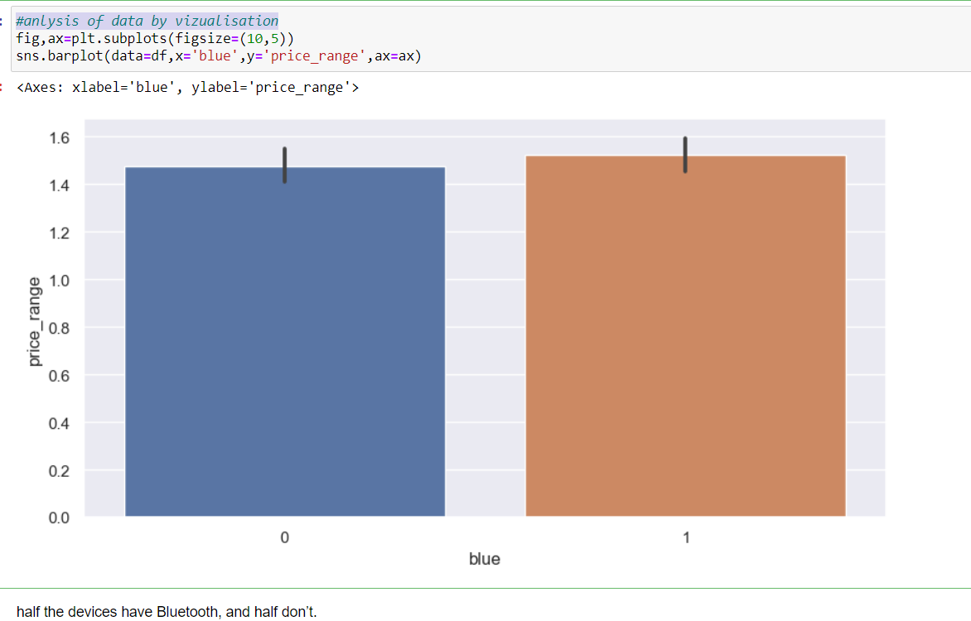
#anlysis of data by vizualisation.

Slide 16
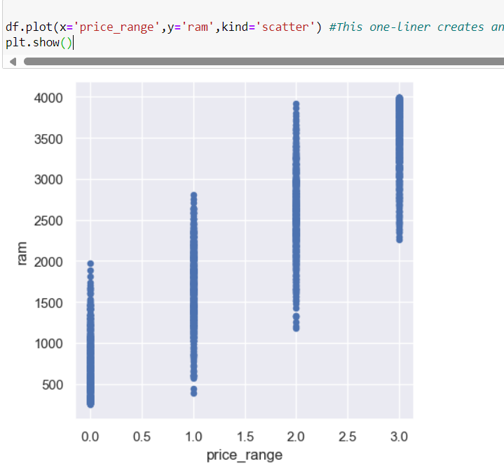
#This one-liner creates and displays a scatter plot using the 'price_range' column as the x-axis and the 'ram' column as the y-axis in the DataFrame 'df'.

Slide 17
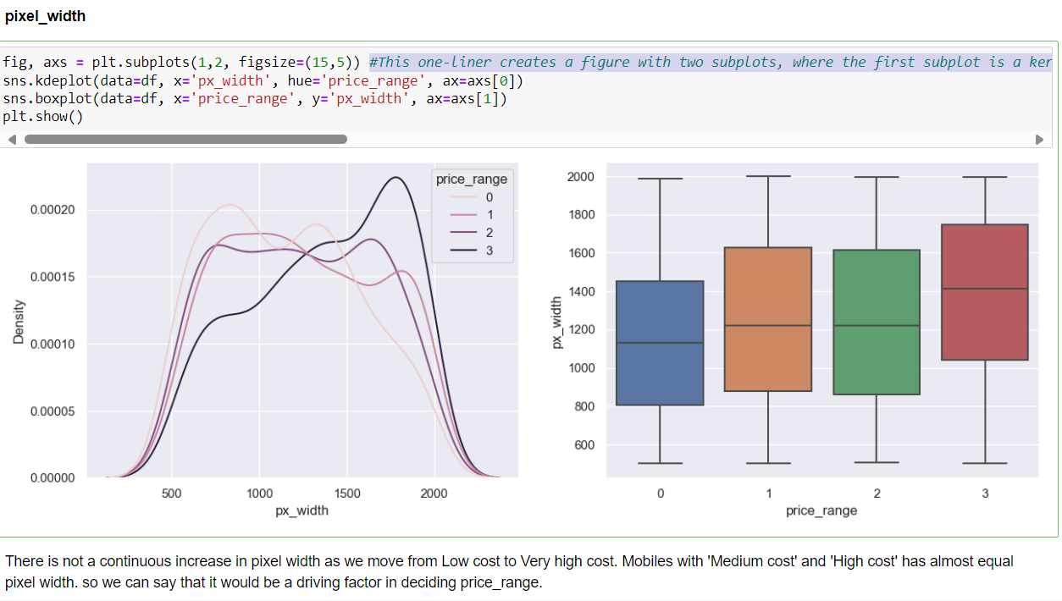
#This one-liner creates a figure with two subplots, where the first subplot is a kernel density plot (kdeplot) of the 'px_width' column colored by 'price_range', and the second subplot is a boxplot of 'px_width' against 'price_range' in the DataFrame 'df'. The figure has a specified size of (15,5), and the plot is displayed using Matplotlib and Seaborn.

Slide 18
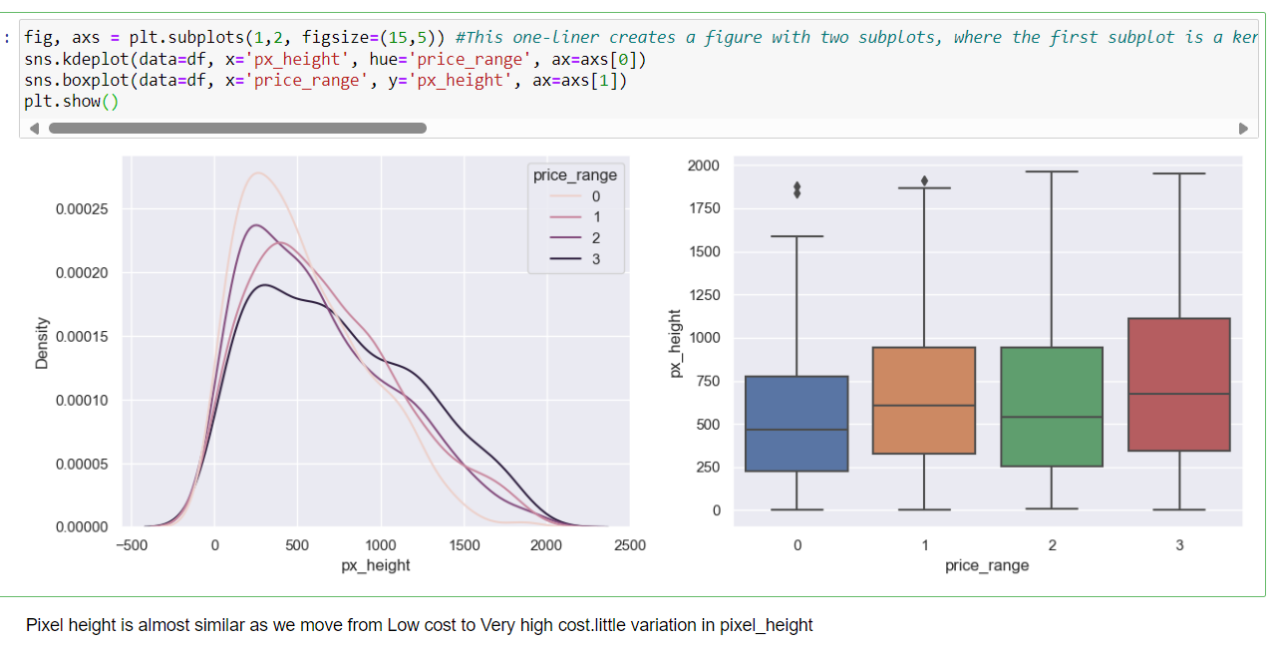
#This one-liner creates a figure with two subplots, where the first subplot is a kernel density plot (kdeplot) of the 'px_height' column colored by 'price_range', and the second subplot is a boxplot of 'px_height' against 'price_range' in the DataFrame 'df'. The figure has a specified size of (15,5), and the plot is displayed using Matplotlib and Seaborn.

Slide 19
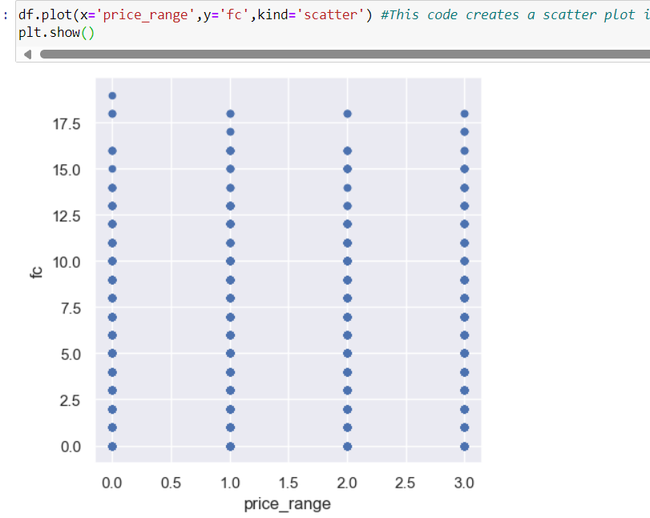
#This code creates a scatter plot illustrating the relationship between 'price_range' and 'fc' variables from the DataFrame 'df'.

Slide 20
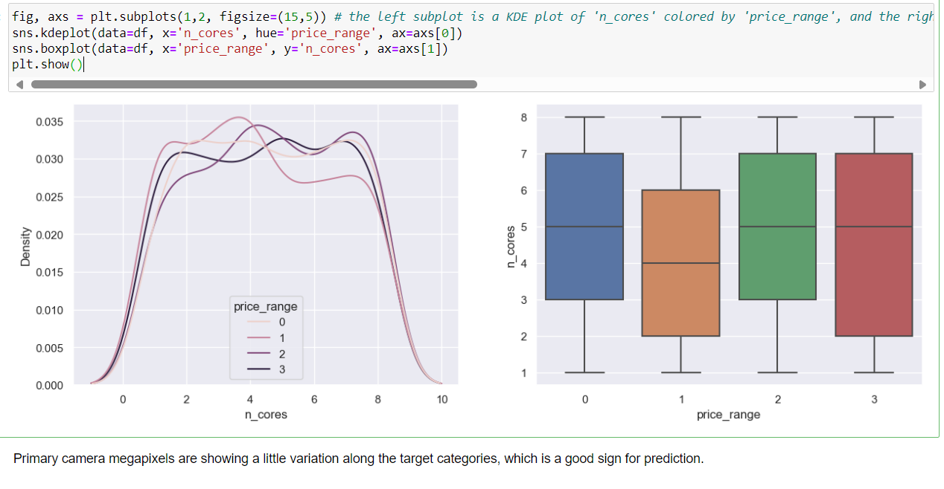
# the left subplot is a KDE plot of 'n_cores' colored by 'price_range', and the right subplot is a boxplot showing the distribution of 'n_cores' across different 'price_range' categories in the DataFrame 'df'.

Slide 21
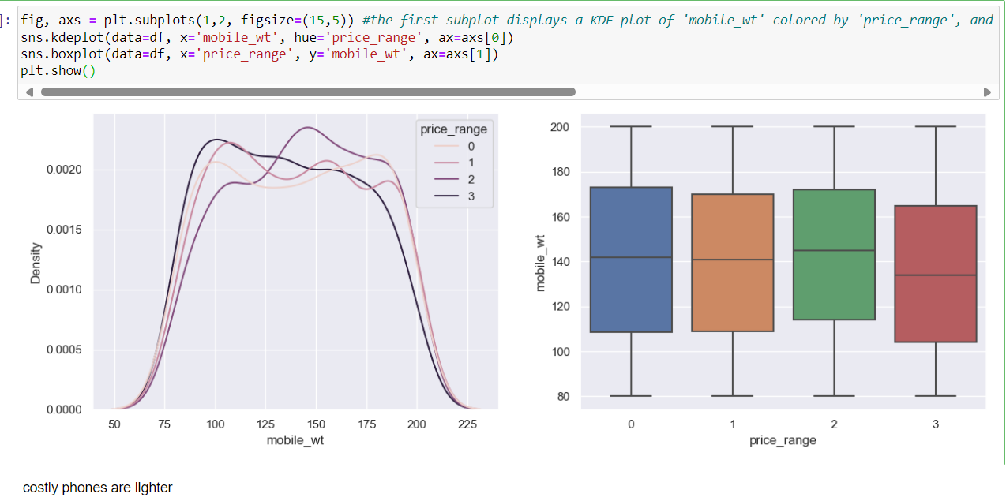
#the first subplot displays a KDE plot of 'mobile_wt' colored by 'price_range', and the second subplot shows a boxplot of 'mobile_wt' against 'price_range' from the DataFrame 'df'.

Slide 22
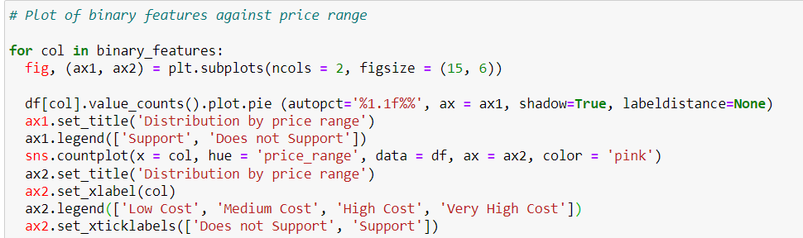
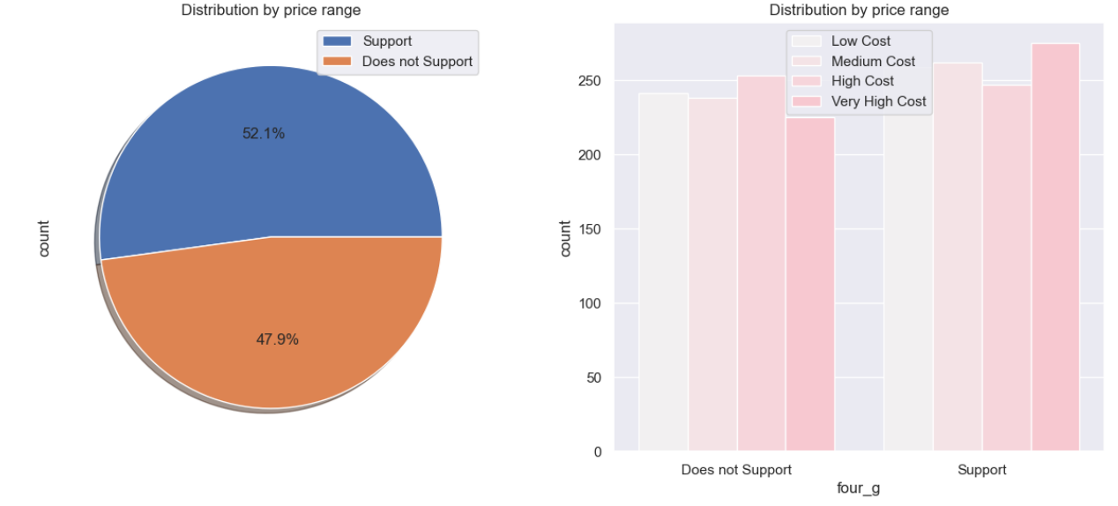
# Plot of binary features against price range:

Slide 23

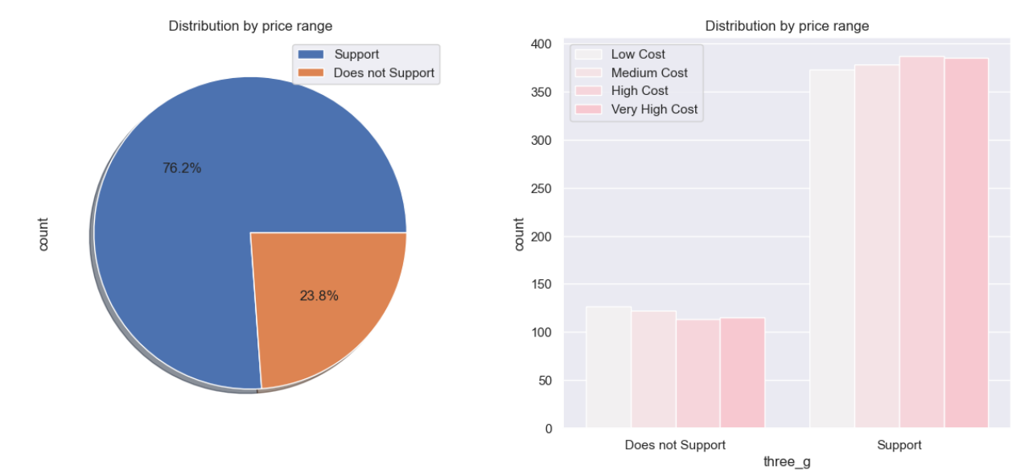

Slide 24
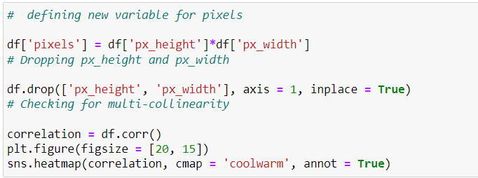
HEATMAP:

Slide 25
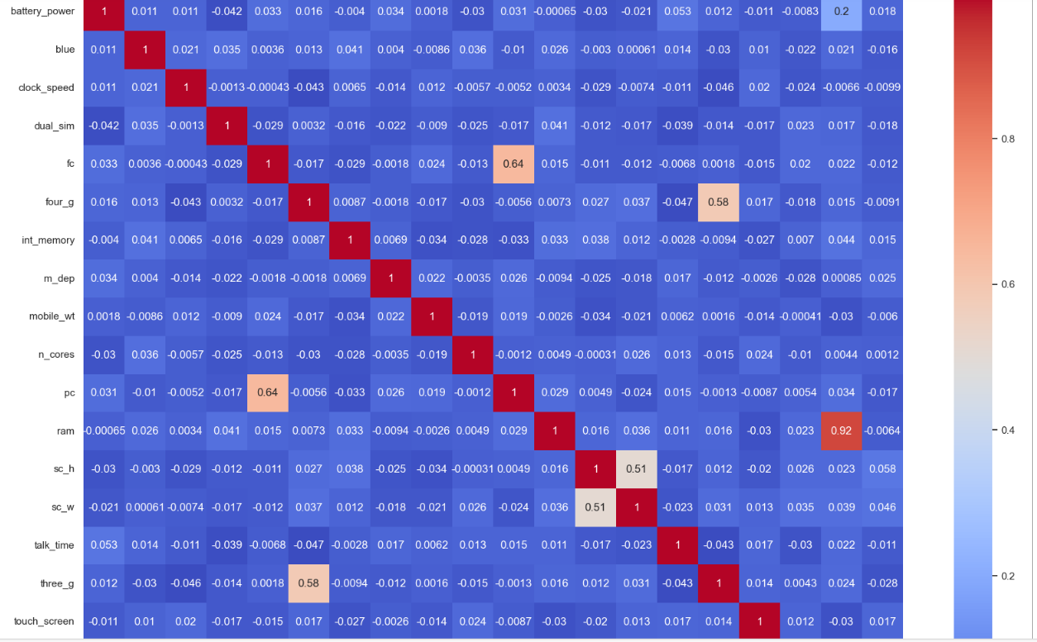

Slide 26
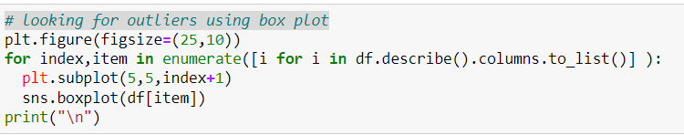
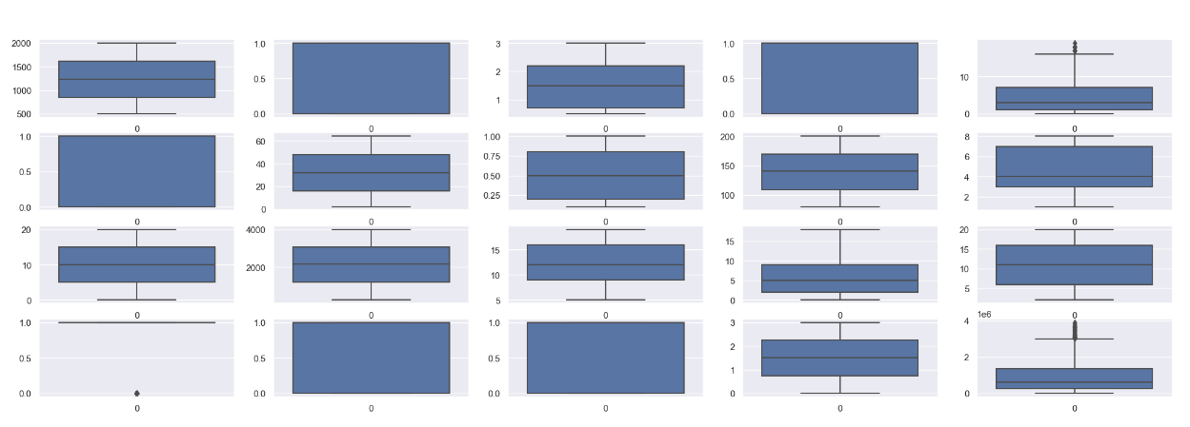
# looking for outliers using box plot:

Slide 27
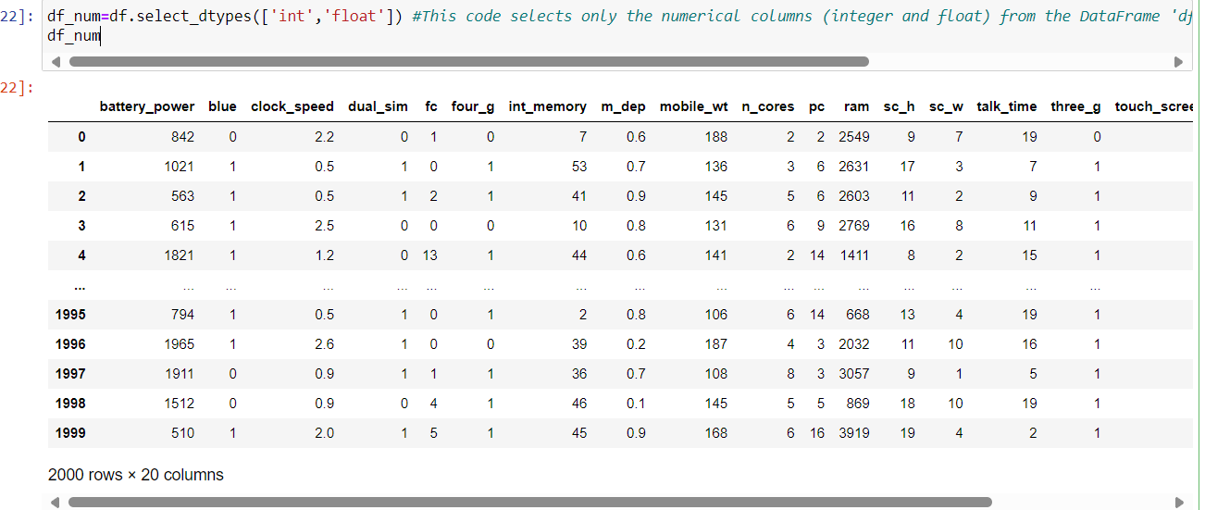
#This code selects only the numerical columns (integer and float) from the DataFrame 'df' and assigns them to a new DataFrame 'df_num'.

Slide 28
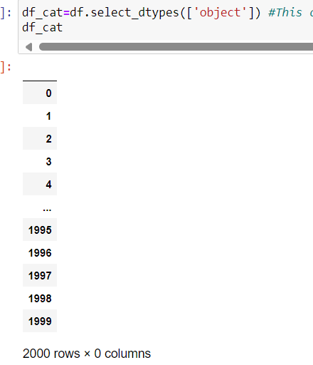
#This code selects only the categorical columns (object type) from the DataFrame 'df' and assigns them to a new DataFrame 'df_cat'.

Slide 29
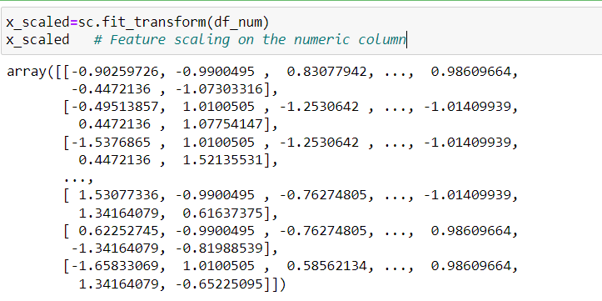
# Feature scaling on the numeric column.

Slide 30
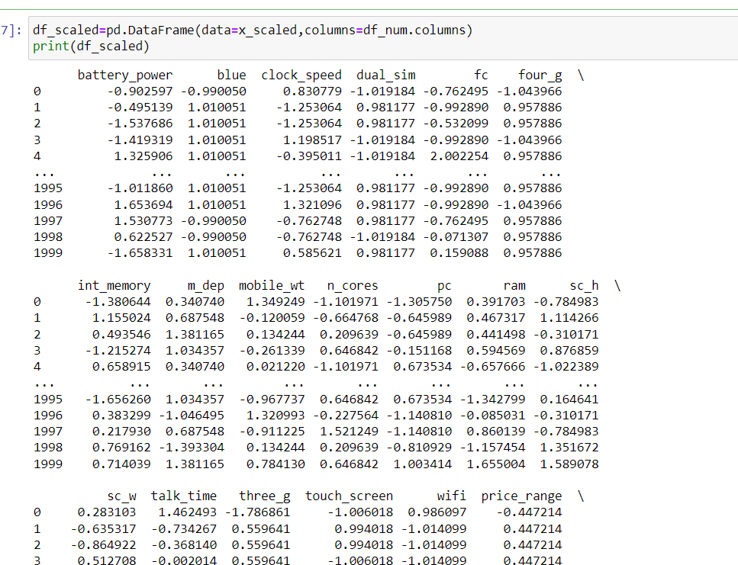
#This code snippet creates a DataFrame called `df_scaled` containing scaled numerical data `x_scaled` with column names from `df_num`.

Slide 31
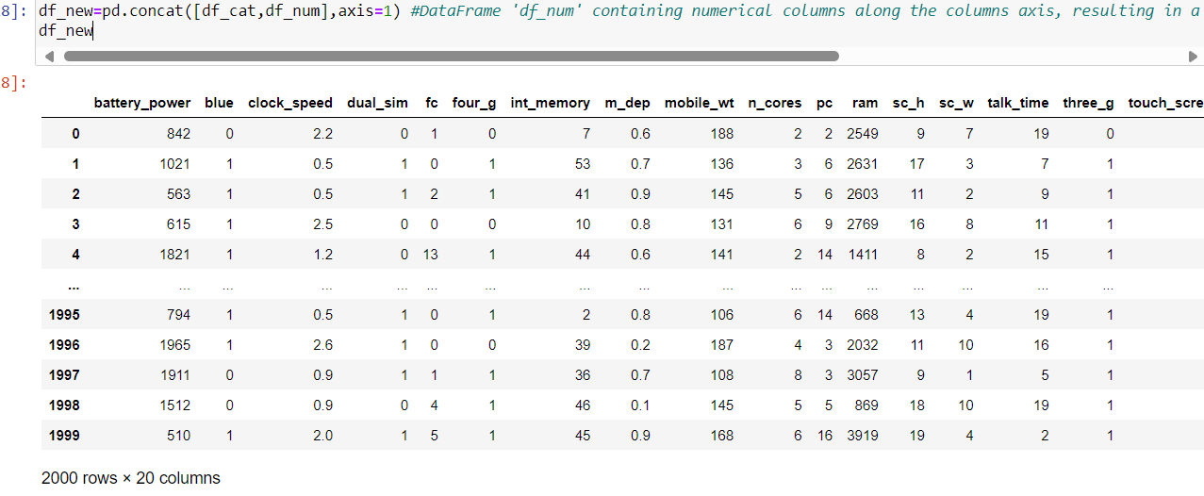
#DataFrame 'df_num' containing numerical columns along the columns axis, resulting in a new DataFrame 'df_new' containing both types of columns.

Slide 32
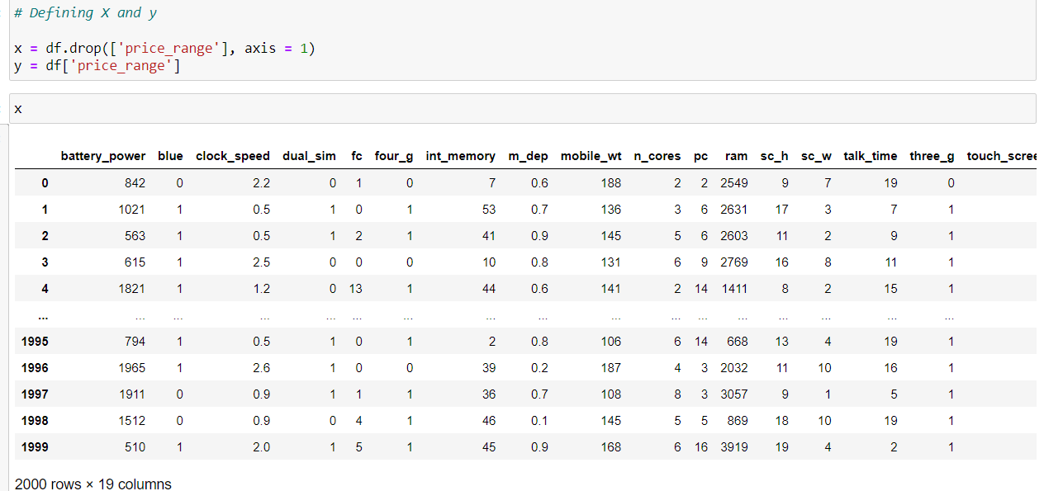
Splitting the X and Y:

Slide 33
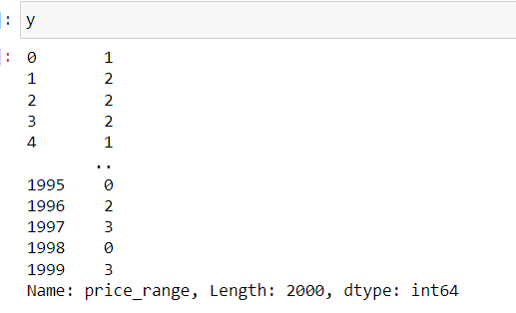

Slide 34
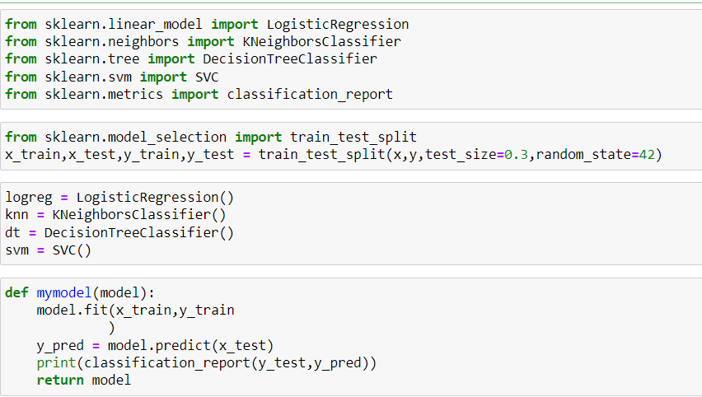
# Importing the models and Traning them all at once.

Slide 35
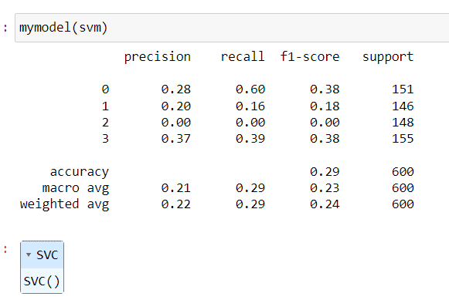
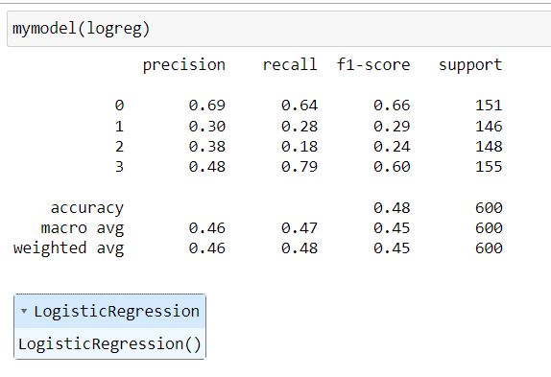
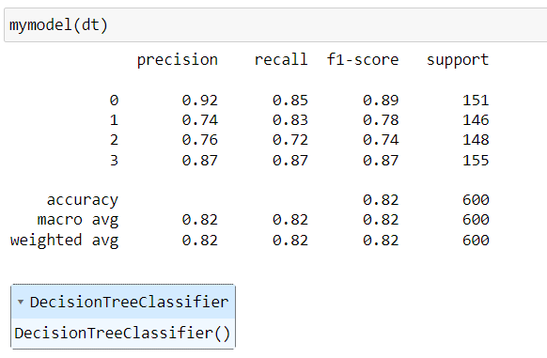
Logistic Regression:

Slide 36
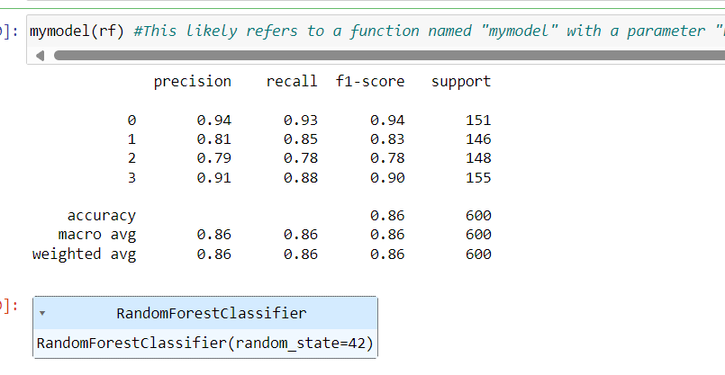
#This likely refers to a function named "mymodel" with a parameter "rf," suggesting it's a custom function for building a machine learning model, potentially using a random forest algorithm.

Slide 37
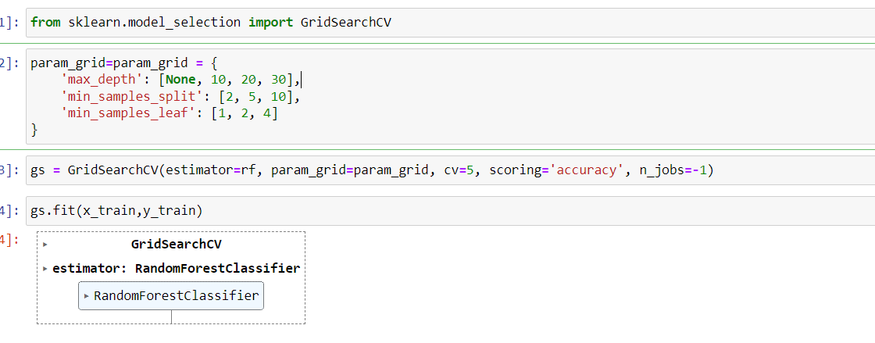
Gridsearch using random forest:

Slide 38
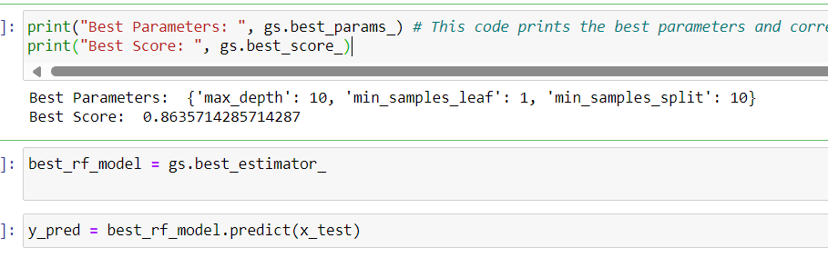
# This code prints the best parameters and corresponding score achieved during grid search optimization for a machine learning model.

Slide 39
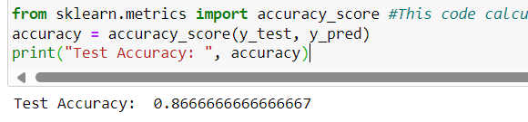
#This code calculates and prints the accuracy score of predictions 'y_pred' compared to actual labels 'y_test' using sklearn's accuracy_score function.

Slide 40
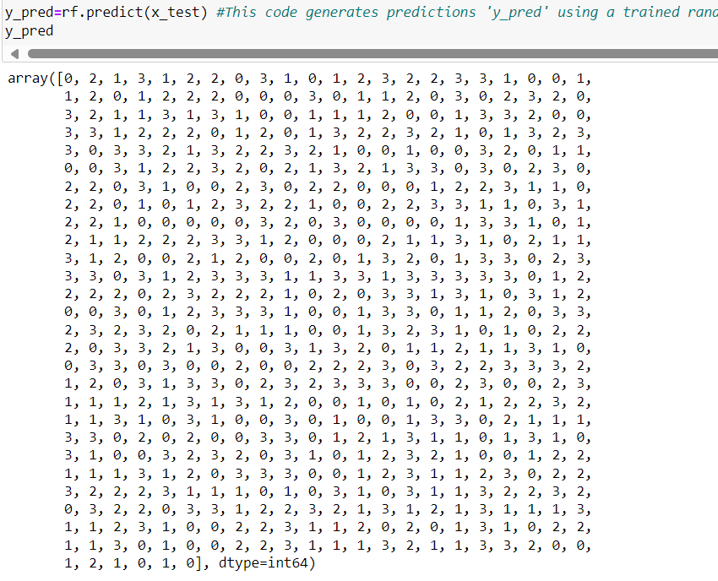
#This code generates predictions 'y_pred' using a trained random forest model 'rf' on the test dataset 'x_test'.

Slide 41
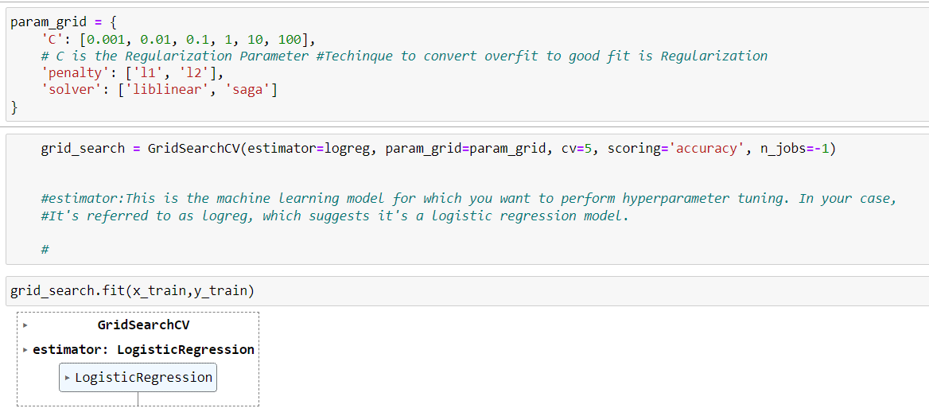
Gridsearch using logisticregression:

Slide 42
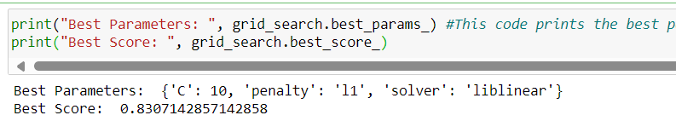
#This code prints the best parameters and corresponding score achieved during grid search optimization using sklearn's GridSearchCV.

Slide 43
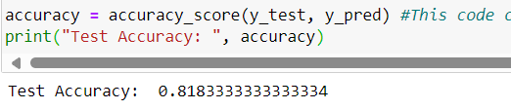
#This code calculates the accuracy score of predicted labels 'y_pred' compared to actual labels 'y_test' using sklearn's accuracy_score function and prints it.

Slide 44
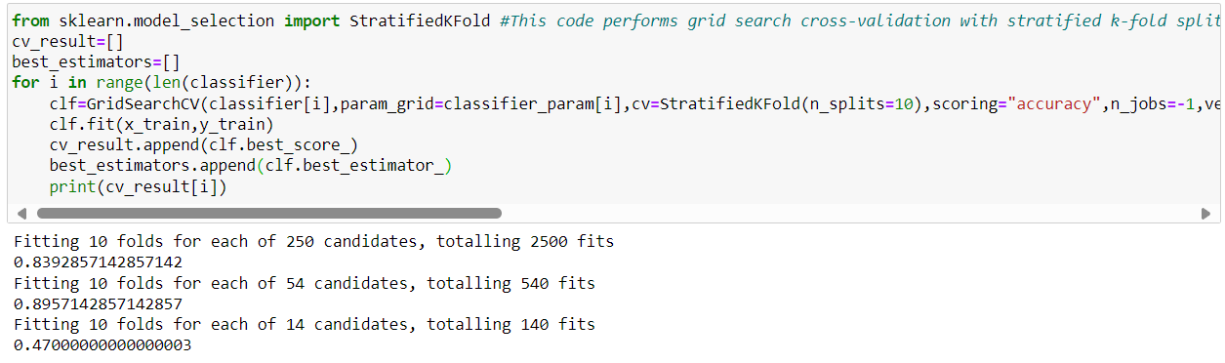
#This code performs grid search cross-validation with stratified k-fold splitting, optimizing classifiers from a list 'classifier' with corresponding parameter grids 'classifier_param' using accuracy as the scoring metric, and prints the best score for each classifier

Slide 45
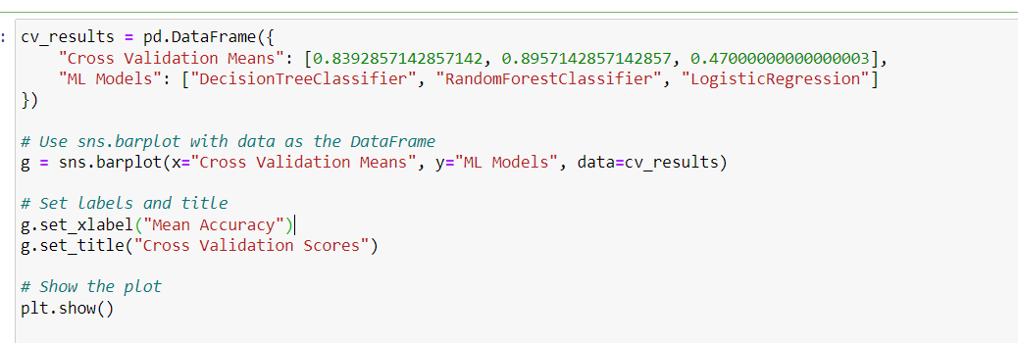
Model Comparison and Conclusions:

Slide 46
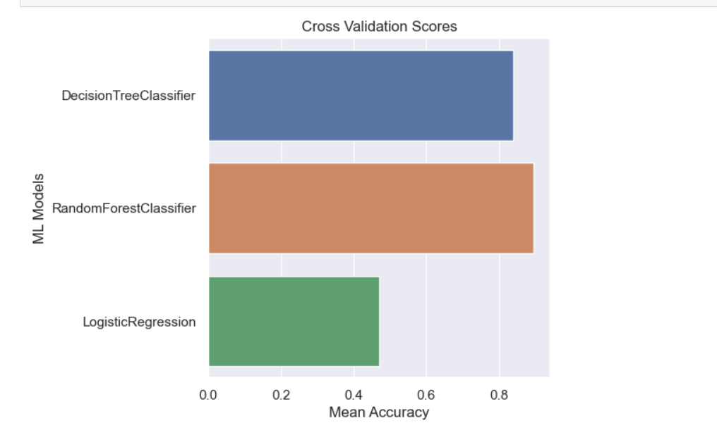

Slide 47


